Slide 1

Introduction
This project involves a comprehensive analysis of a real estate dataset from Nashville. Utilizing Python, specifically the Pandas library for data manipulation and Matplotlib for visualization, we've examined various aspects of the real estate market, including sales prices, property values, and the impact of property age on its sale price.

Slide 2

Objective
The primary objective is to understand the dynamics of the Nashville real estate market, identifying trends in sales, profitability, and valuation over time. This includes cleaning and preparing the data, detecting outliers, and analyzing patterns of increase or decrease in property values relative to their sale prices

Slide 3

Goal
The goal is to extract meaningful insights that could inform investment decisions, property valuations, and market predictions. This involves:
Identifying properties sold at a profit or loss and quantifying these outcomes.
Understanding the annualized increase or decrease in property values.
Segmenting the data by various demographics, such as city and street, to identify high-value areas

Slide 4

Visualization

Slide 5

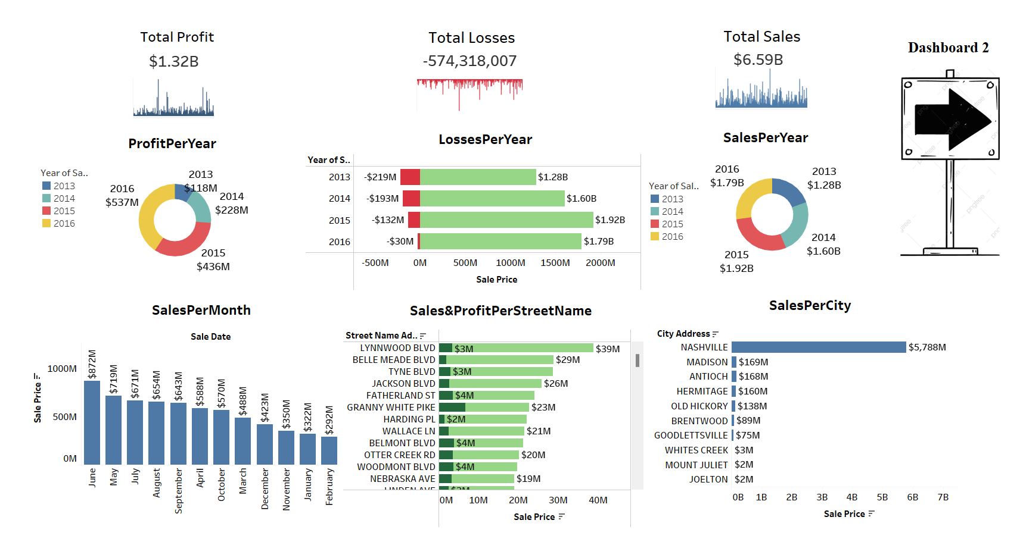
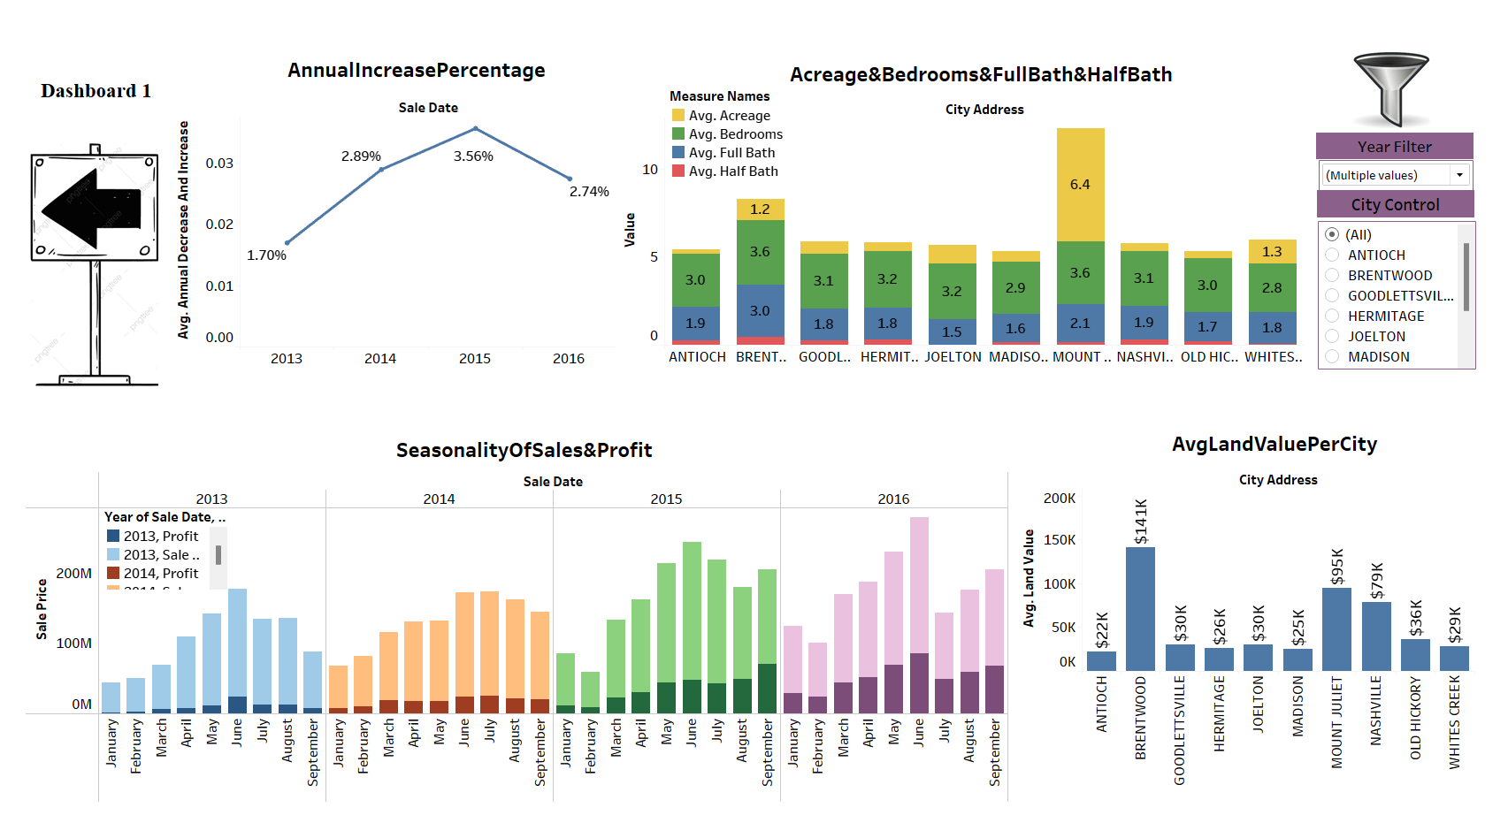
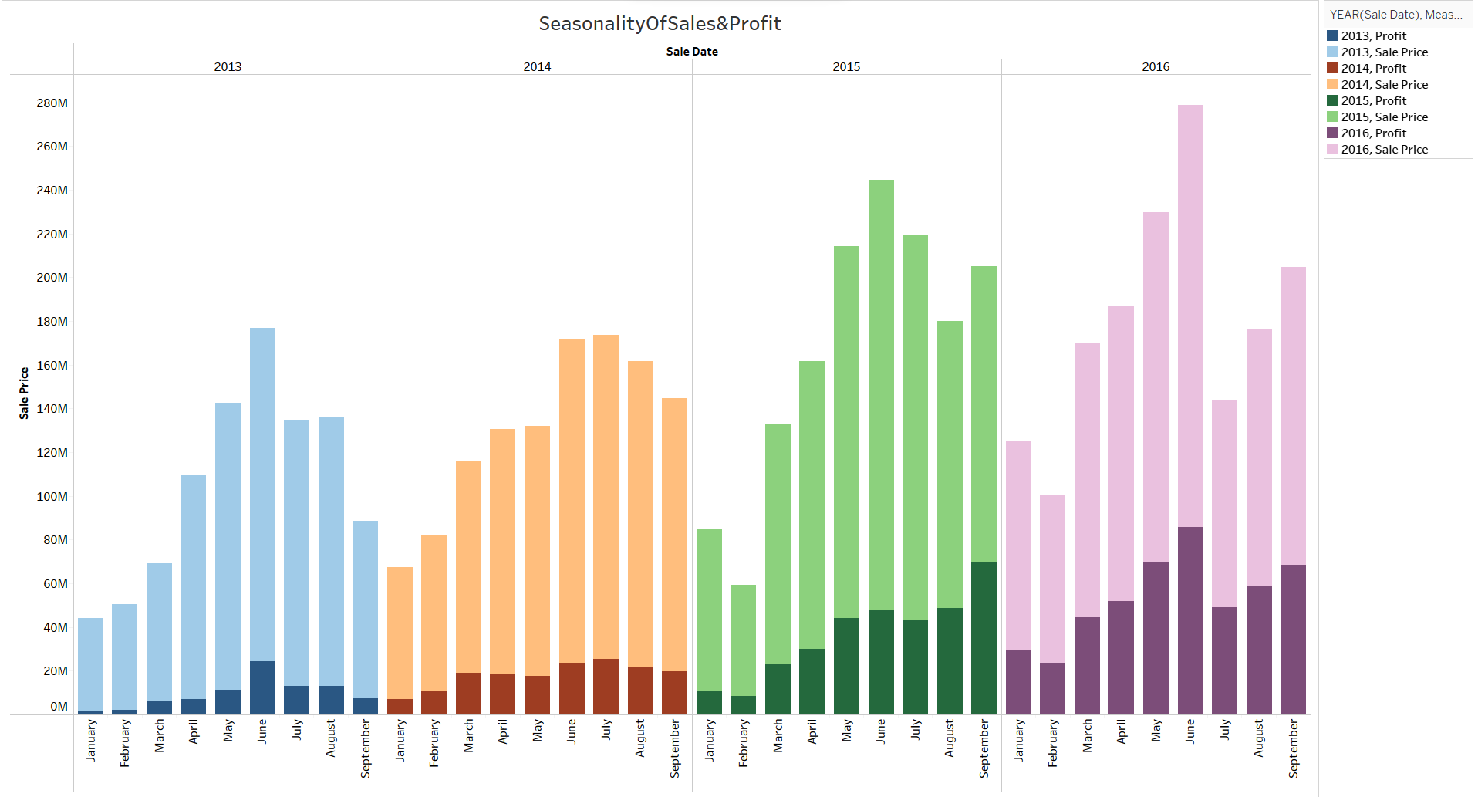
This dashboard provides a high-level overview of a real estate project's financial performance. It includes data on total profit, losses, sales, and more detailed breakdowns by year, month, street name, and city.
Total Profit: $1.32 billion, with the highest yearly profit in 2016 at $537 million.
Total Losses: $574 million, with losses decreasing significantly by 2016.
Total Sales: $6.59 billion, indicating that overall sales are high despite the losses.
Sales and Profit Per Year: Sales peaked in 2015, while profits were highest in 2016.
Sales Per Month: Highest in June at $1.78 billion.
Sales & Profit Per Street Name: Top-performing streets are Lynwood Blvd and Belle Meade Blvd, both with $39 million in profits.
Sales Per City: Nashville leads with $5.788 billion in sales.
The dashboard suggests a growing project with substantial sales and reducing losses over time, particularly strong in specific locations like Nashville

Slide 6

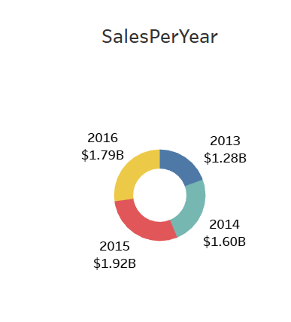
This dashboard, Dashboard 1, provides insights into the growth and characteristics of a real estate project, including yearly increases, property features by city, seasonal sales trends, and land values.
Annual Increase Percentage: There's a growth trend with a peak increase of 3.56% in 2015, slightly declining to 2.74% in 2016.
Acreage & Bedrooms & Full Bath & Half Bath: It compares the average acreage, bedrooms, and bathrooms across cities. Madison has notably higher average values, especially in acreage and full baths.
Seasonality Of Sales & Profit: This displays sales and profit by month for different years, showing variability and possibly seasonal trends.
Avg Land Value Per City: Highlights the average land value in different cities, with Nashville having the highest value at approximately $194K, followed by Brentwood and Hermitage.
The data shows a generally increasing trend in sales percentages annually, variability in property features by city, and seasonal patterns in sales and profits. Nashville stands out with high land values.

Slide 7

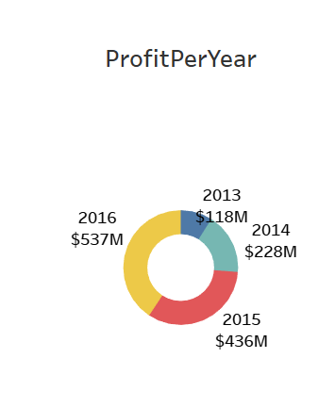
This chart shows the seasonal variation of sales and profit for a real estate project in Nashville across four years, 2013 to 2016. Each year, sales and profits seem to peak around the middle months (June to September), indicating a strong seasonal trend. Over the years, there's a general upward trend, with both sales and profit increasing, especially noticeable in 2016 where both metrics appear significantly higher compared to previous years. This suggests growing market strength and possibly effective sales strategies being implemented.

Slide 8

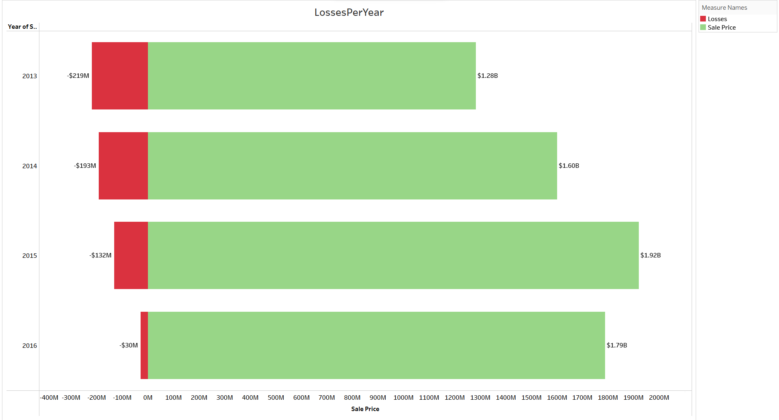
The chart presents annual sales for a project over a four-year period. Sales have increased each year from $1.28 billion in 2013 to $1.79 billion in 2016, indicating consistent growth in the project's revenue year over year. The upward trend suggests strong market performance and increasing sales effectiveness

Slide 9

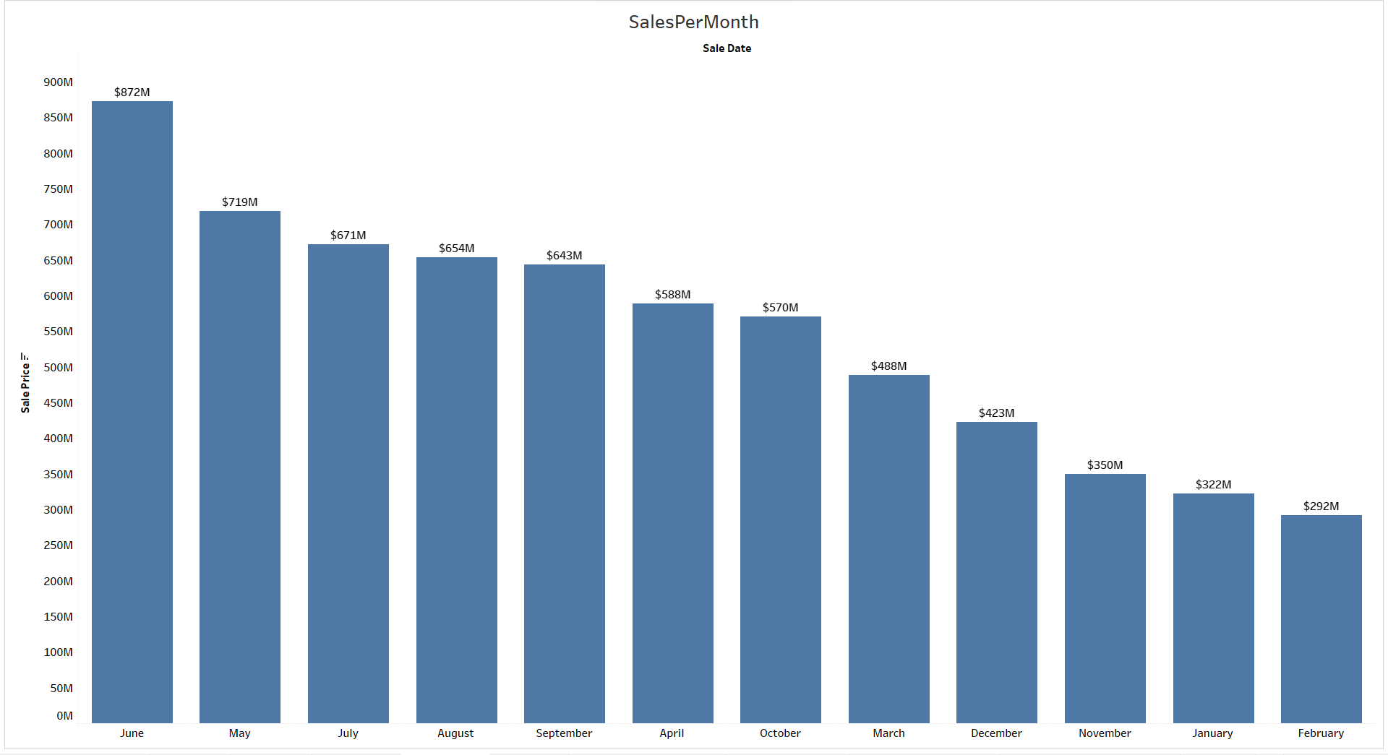
The chart displays profits per year for a project, showing an upward trend from 2013 to 2016. Profits have grown significantly from $118 million in 2013 to $537 million in 2016, indicating increasing profitability and likely successful management and operational strategies over these years

Slide 10

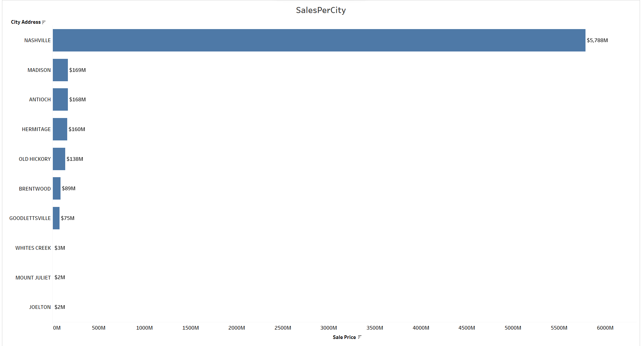
The chart depicts losses per year for a project against the total sale price for the years 2013 to 2016. The losses have decreased significantly over time, from $219 million in 2013 to just $30 million in 2016. Meanwhile, the sale price has increased each year, indicating improving financial health and efficiency for the project. The data suggests that the project has become more profitable over time, with better management of losses

Slide 11

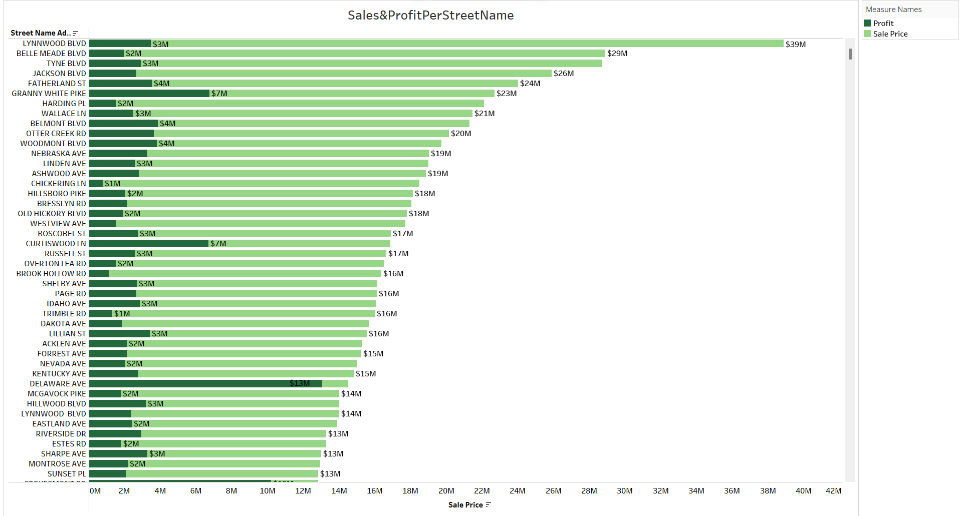
The chart illustrates monthly sales for a real estate project, with the highest sales occurring in June at $872 million, and the lowest in February at $292 million. This indicates a strong seasonal trend with peak sales in the summer months and lower sales in the winter. The pattern suggests that timing plays a significant role in the project's sales performance

Slide 12

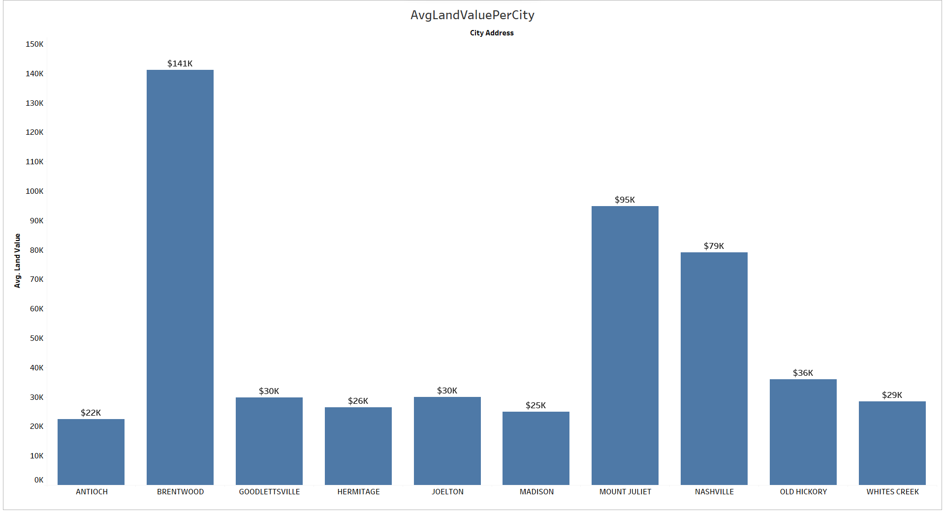
The chart shows sales by city, with Nashville far outpacing other locations at $5.788 billion. Madison and Antioch follow with sales of $169 million and $168 million, respectively. There is a significant drop-off in sales as you move down the list to smaller cities like Whites Creek, Mount Juliet, and Joelton, each with sales around $2-3 million. This distribution indicates that the majority of the project's revenue comes from Nashville, with other cities contributing a smaller portion of sales

Slide 13

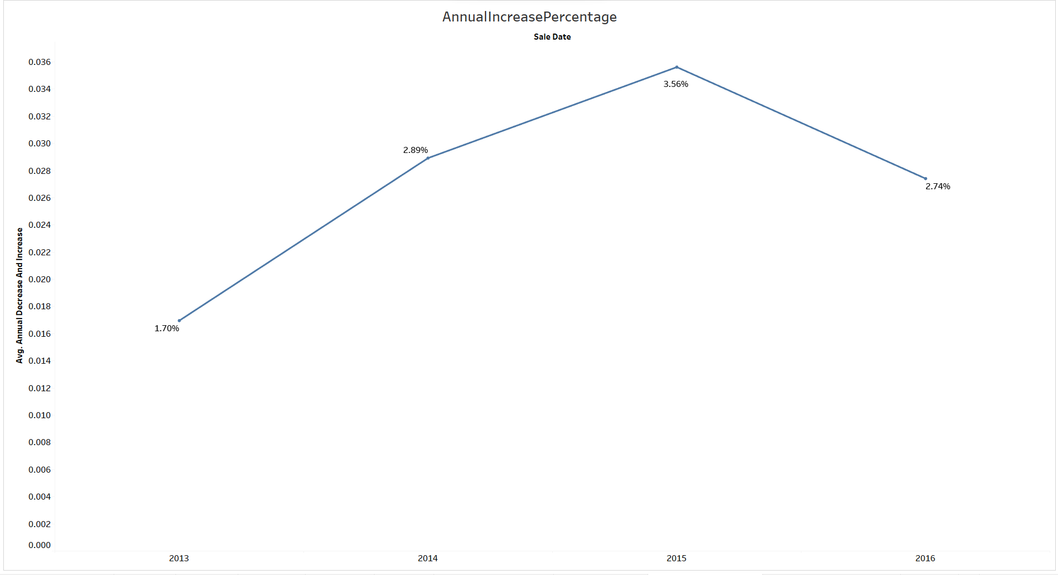
The chart displays sales and profit per street name for a real estate project. Lynwood Blvd and Belle Meade Blvd are the top performers with $39 million in profit each. Other streets like Tyne Blvd and Jackson Blvd also show strong performance, though not as high as the top two. The profit is consistently lower than the sales figures, which is expected in business operations. Streets like Granny White Pike and Harding Pl have high profits relative to their sales, suggesting high profitability in those areas. Overall, the chart indicates which streets are the most lucrative for the real estate project

Slide 14

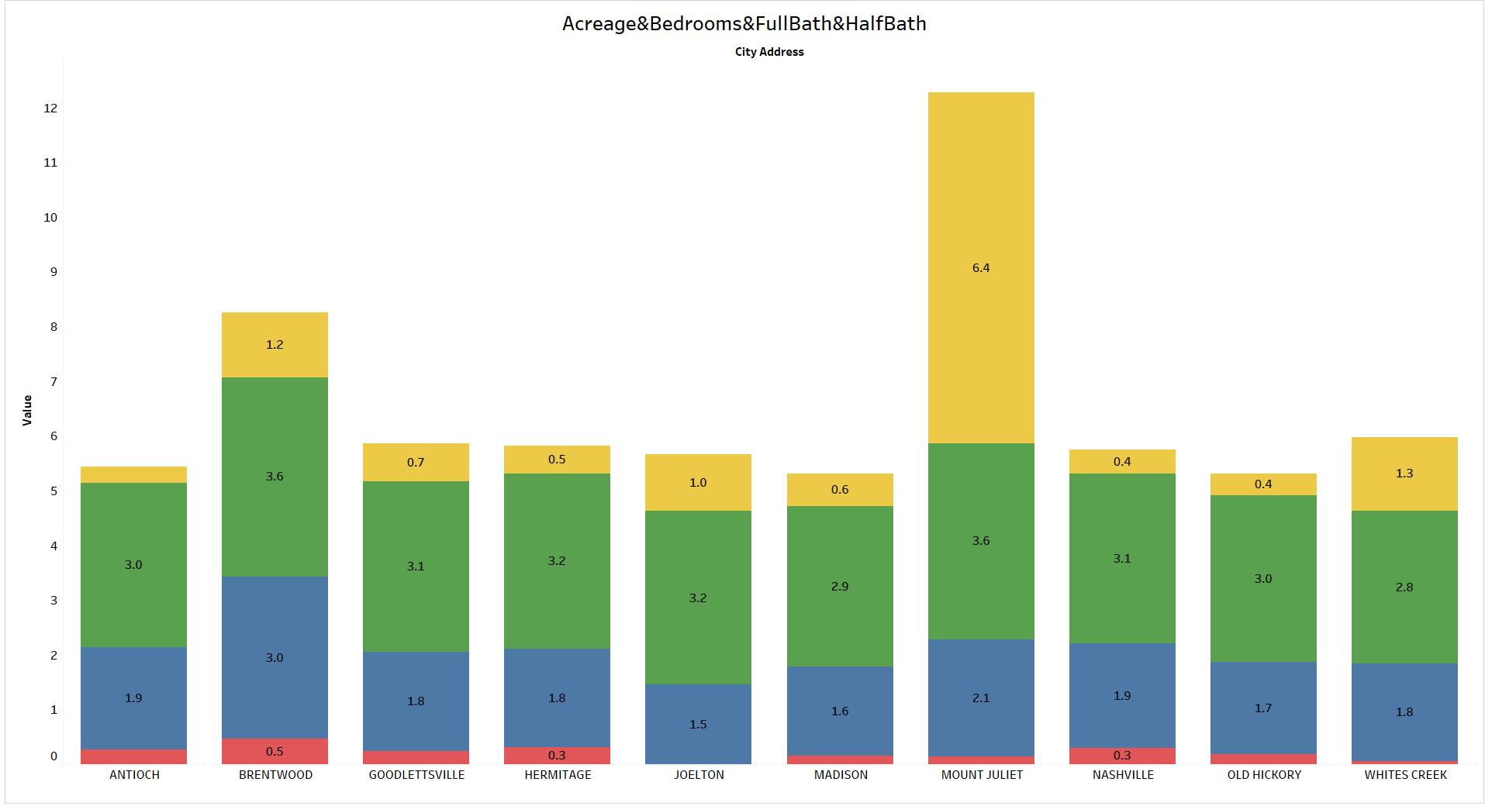
The chart displays the average land value per city for a real estate project. Brentwood has the highest average land value at $141K, significantly more than the other cities. Mount Juliet also stands out with an average value of $95K. In contrast, Antioch, Hermitage, Joelton, Madison, Nashville, Old Hickory, and Whites Creek have lower average land values, ranging from $22K to $79K, with Whites Creek being the lowest. This indicates a disparity in land values across the project's geographic areas, which could reflect differences in demand, development, and other local economic factors

Slide 15

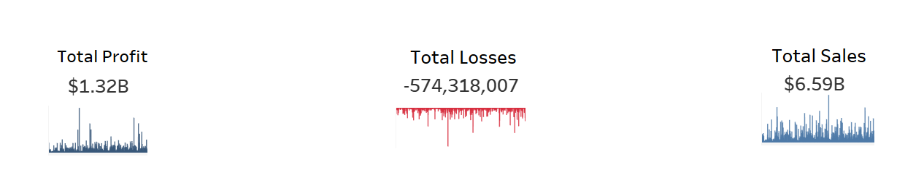
The line chart illustrates the annual increase percentage in sales for a real estate project from 2013 to 2016. There is a rising trend from 1.70% in 2013 to a peak of 3.56% in 2015, followed by a slight decrease to 2.74% in 2016. This suggests that while there was significant growth in sales in the middle of the period, the rate of increase slightly slowed down in the final year

Slide 16

The stacked bar chart compares the average property attributes—acreage, number of bedrooms, full baths, and half baths—across different cities. Madison stands out with the highest average acreage at 6.4, and Brentwood has the most bedrooms on average at 3.6. Hermitage shows the lowest average acreage at 0.3, while Antioch has the least number of average bedrooms at 1.9. This data can indicate varying property sizes and types across these cities, which might reflect local real estate market characteristics or zoning regulations

Slide 17

The image shows key financial metrics for a real estate project:
Total Profit: The project has generated $1.32 billion in total profit.
Total Losses: The total losses amount to $574,318,007.
Total Sales: The project has made $6.59 billion in total sales.
This snapshot indicates a successful project overall, with high sales figures and substantial profit, despite the considerable losses incurred

Slide 18
Python Code

Slide 19
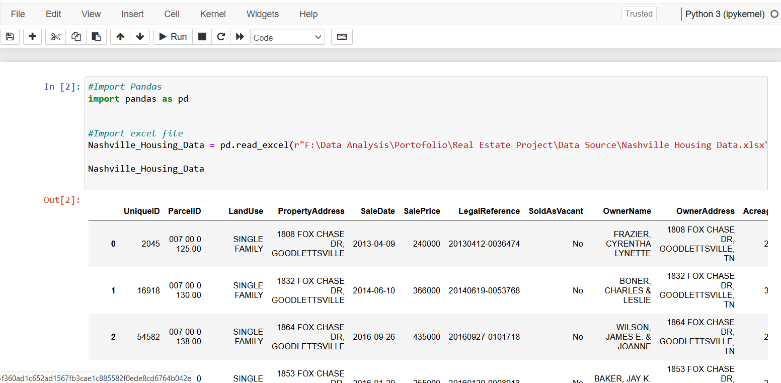
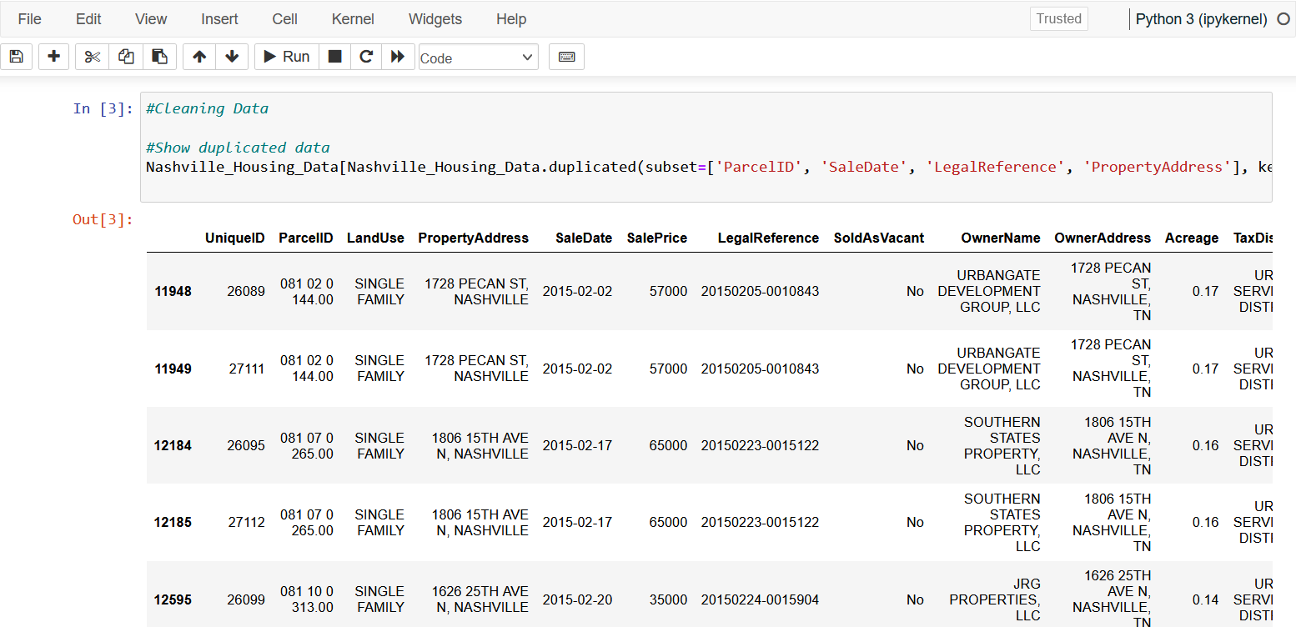
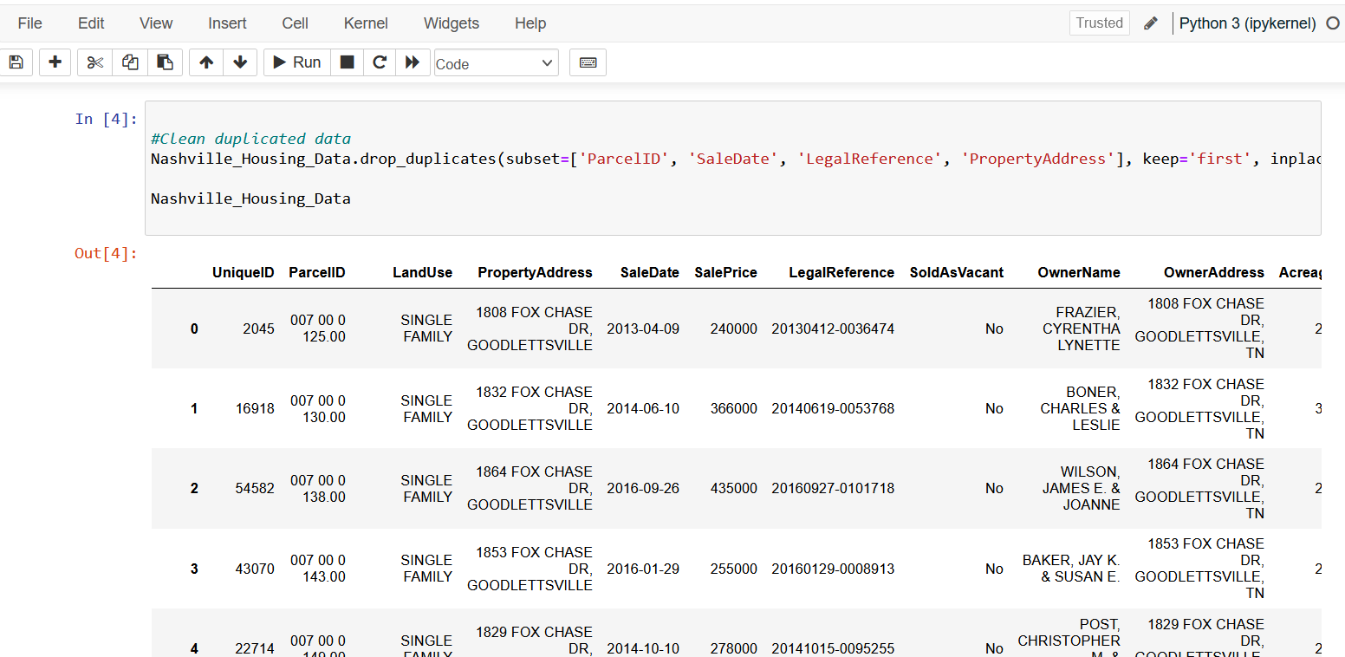
This Python code snippet is for importing a dataset into a Pandas DataFrame. The dataset is an Excel file named "Nashville Housing Data.xlsx" located at the given file path. The code uses the Pandas library, which is a powerful tool for data analysis in Python, to read the Excel file into a DataFrame named Nashville_Housing_Data. After reading the file, the DataFrame is displayed, which will contain the housing data from the Excel file for further analysis. The actual analysis of the real estate project would involve additional steps after this code snippet, where the loaded data would be explored, manipulated, and analyzed using various Pandas functions and methods

Slide 20

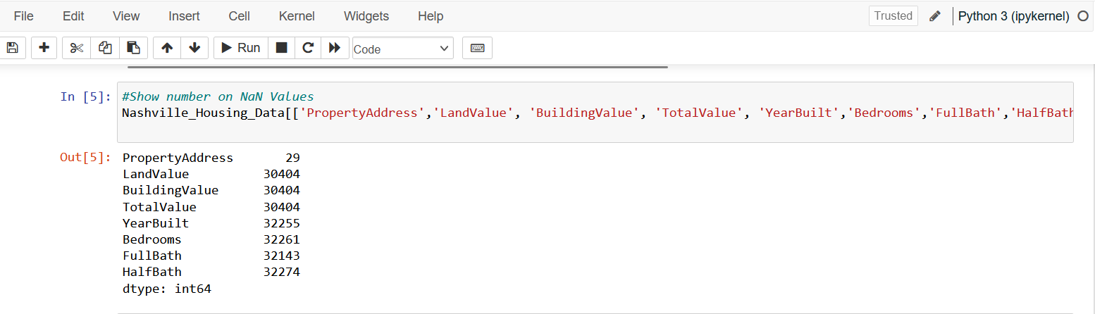
This Python code is a continuation of the previous snippet for data cleaning, specifically targeting duplicate entries in the real estate dataset. The code is using the Pandas library to identify and display rows in the Nashville_Housing_Data DataFrame that have duplicate values in the 'ParcelID', 'SaleDate', 'LegalReference', and 'PropertyAddress' columns.
The duplicated() function checks for duplicate rows based on the specified subset of columns. The keep=False parameter indicates that all instances of duplicate rows should be marked as duplicated (not just the first or last occurrence). This is useful for reviewing all the data that could potentially be redundant before deciding on further actions like removing these duplicates

Slide 21
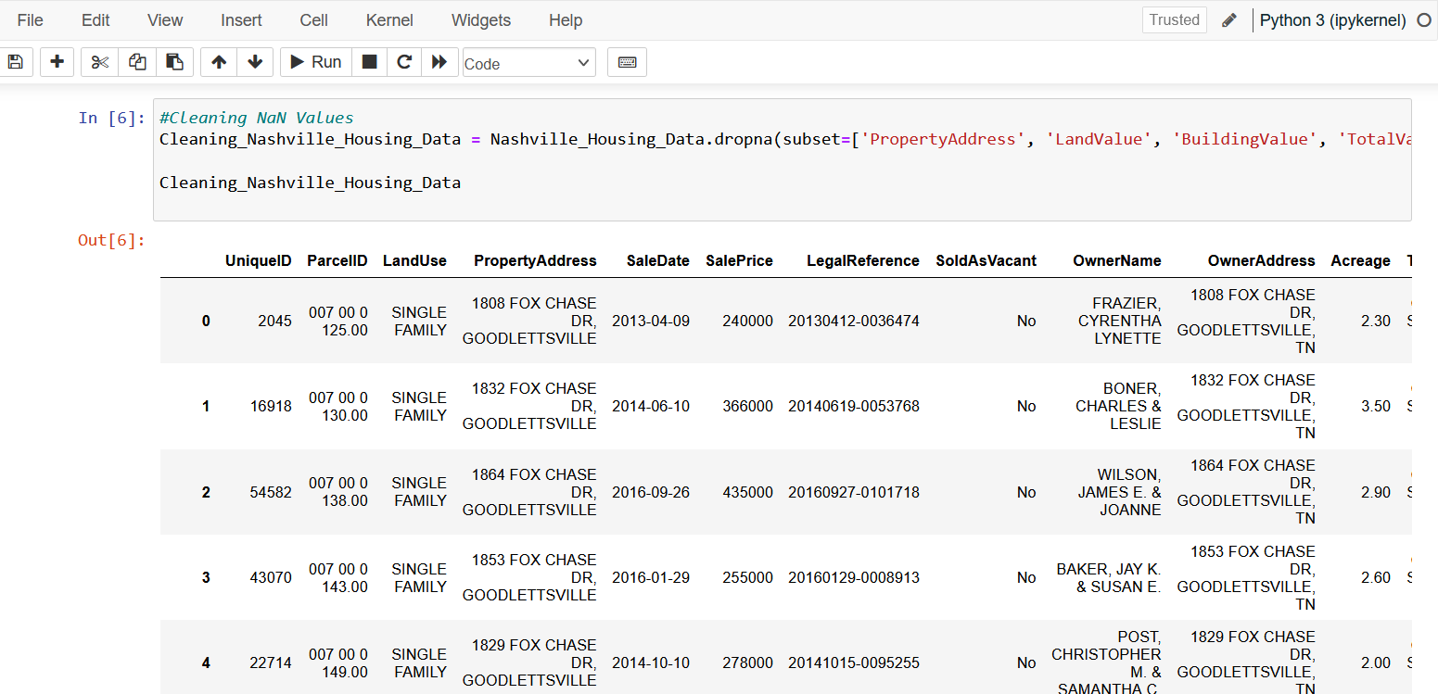
This code removes duplicate rows from the Nashville_Housing_Data DataFrame based on the specified subset of columns—'ParcelID', 'SaleDate', 'LegalReference', and 'PropertyAddress'. The drop_duplicates() method is used with keep='first' to keep the first occurrence of the duplicates and remove the rest. The inplace=True argument applies the changes directly to the DataFrame without the need to assign the result to a new DataFrame.
After this operation, the DataFrame should have no duplicate entries based on the specified columns, and the code then displays the cleaned Nashville_Housing_Data DataFrame

Slide 22

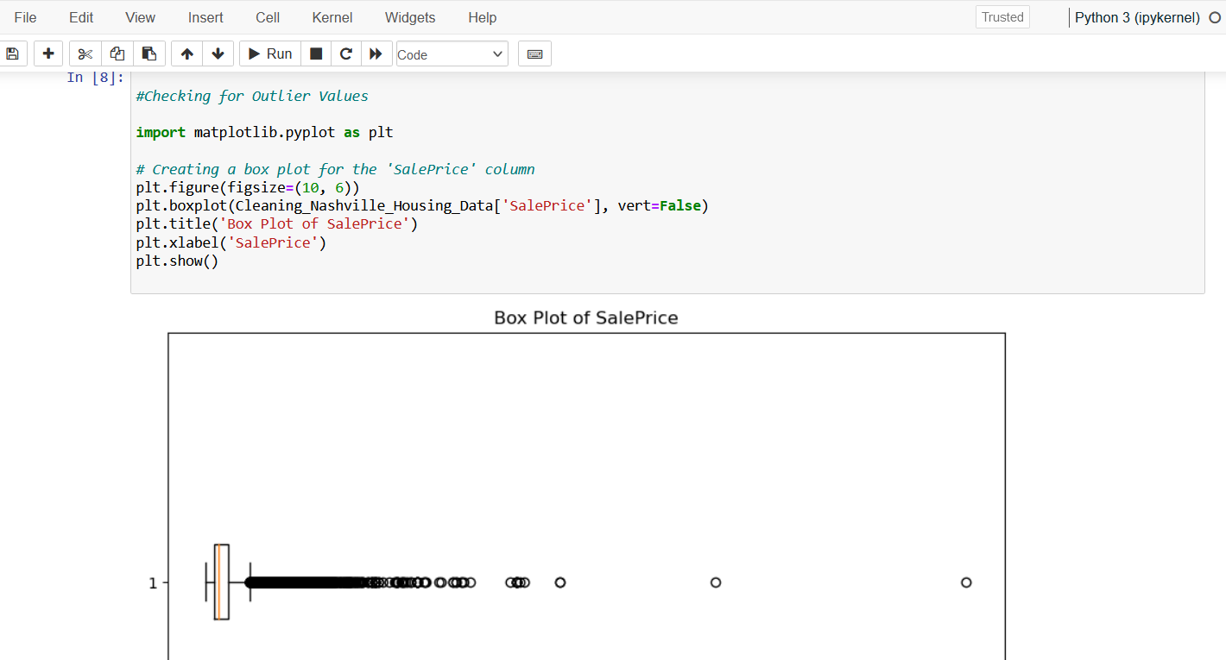
This code is used to count the number of missing values (NaNs) in the specified columns of the Nashville_Housing_Data DataFrame. It's inspecting the columns 'PropertyAddress', 'LandValue', 'BuildingValue', 'TotalValue', 'YearBuilt', 'Bedrooms', 'FullBath', and 'HalfBath'. The .isnull() method identifies missing values in the DataFrame, and the .sum() method then counts the number of True values (which represent NaNs) in each of the specified columns. The result will be a series where the index is the column names and the values are the counts of NaNs in each column

Slide 23

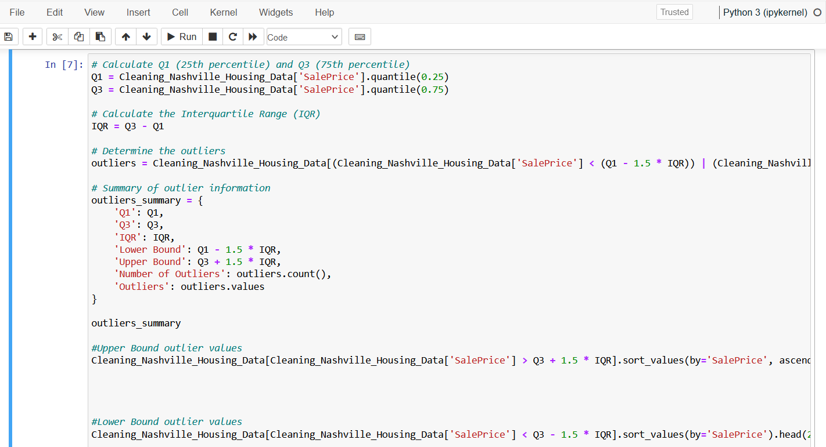
The provided code snippet creates a new DataFrame named Cleaning_Nashville_Housing_Data by removing rows from the Nashville_Housing_Data DataFrame where there are NaN (Not a Number) values in any of the specified columns—'PropertyAddress', 'LandValue', 'BuildingValue', 'TotalValue', 'YearBuilt', 'Bedrooms', 'FullBath', and 'HalfBath'. The dropna() function is used with the subset argument to target these specific columns, and only rows that have NaN in these fields will be dropped.
After this operation, Cleaning_Nashville_Housing_Data will have a cleaned dataset without any missing values in the listed columns, which is important for accurate analysis and modeling. The last line of code likely aims to display the resulting DataFrame after the cleaning process

Slide 24
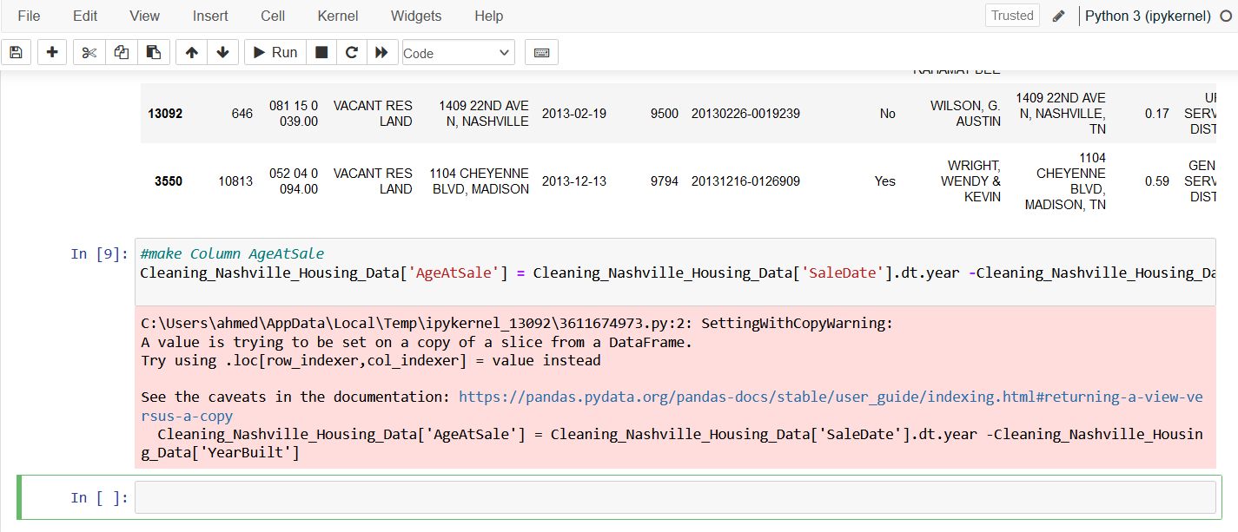
This code is for detecting outliers in the 'SalePrice' column of the Cleaning_Nashville_Housing_Data DataFrame using a box plot visualization. It employs the Matplotlib library for plotting:
It imports the matplotlib.pyplot module for plotting.
It sets up a new figure with a specified size of 10x6 inches.
It creates a box plot for the 'SalePrice' column. The vert=False parameter is used to make the box plot horizontal.
It sets a title for the plot as 'Box Plot of SalePrice'.
It sets the label for the x-axis as 'SalePrice'.
Finally, it displays the plot with plt.show().
When executed, this code will show a box plot visualizing the spread of the 'SalePrice' values, which can help identify outliers as points that appear far from the rest of the data (beyond the whiskers of the box plot)

Slide 25
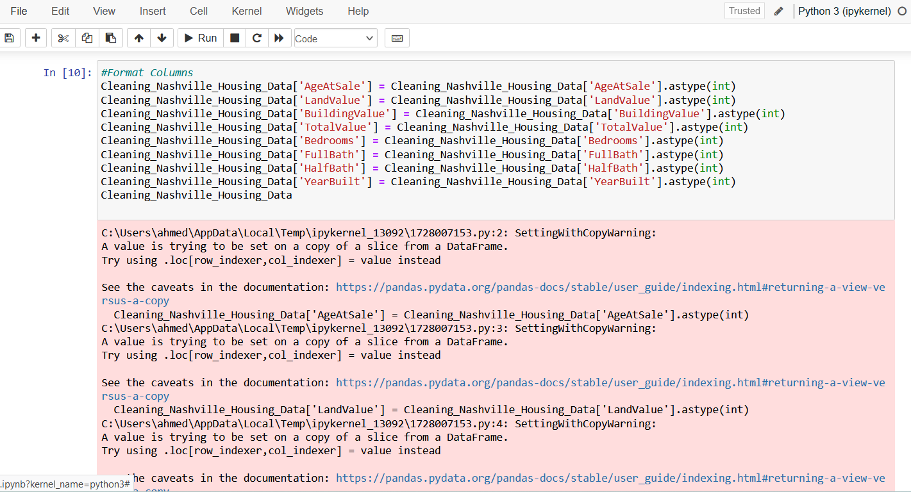
This code detects and analyzes outliers in the 'SalePrice' column of the Cleaning_Nashville_Housing_Data DataFrame by calculating Q1 and Q3, the IQR, and identifying sales outside 1.5 * IQR as outliers. It then summarizes and lists the top 20 highest and lowest outliers for further analysis. This helps pinpoint potential anomalies in sale prices for investigation or exclusion to ensure accurate analysis.

Slide 26
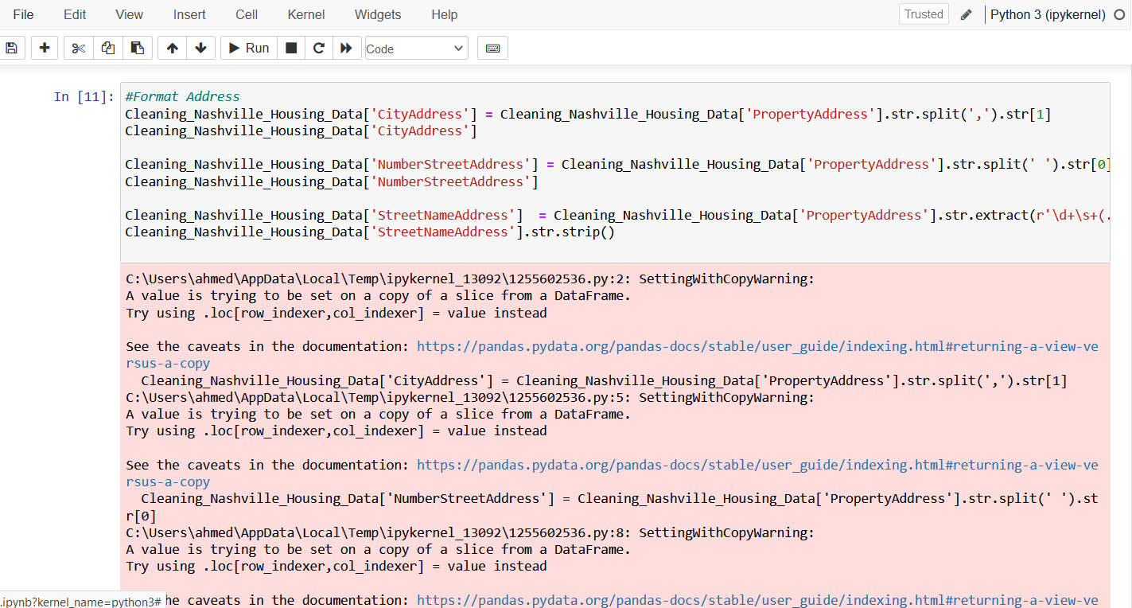
The code snippet provided adds a new column named 'AgeAtSale' to the Cleaning_Nashville_Housing_Data DataFrame. This new column is calculated by subtracting the 'YearBuilt' of each property from the sale year extracted from the 'SaleDate' column. The .dt.year accessor is used to get the year part from the 'SaleDate' datetime-like object.
As a result, 'AgeAtSale' will represent the age of each property at the time it was sold, giving insight into the relative newness or age of the properties in the dataset at the time of their sale. This information can be valuable for various analyses, including those that examine the impact of a property’s age on its sale price or appeal to buyers

Slide 27

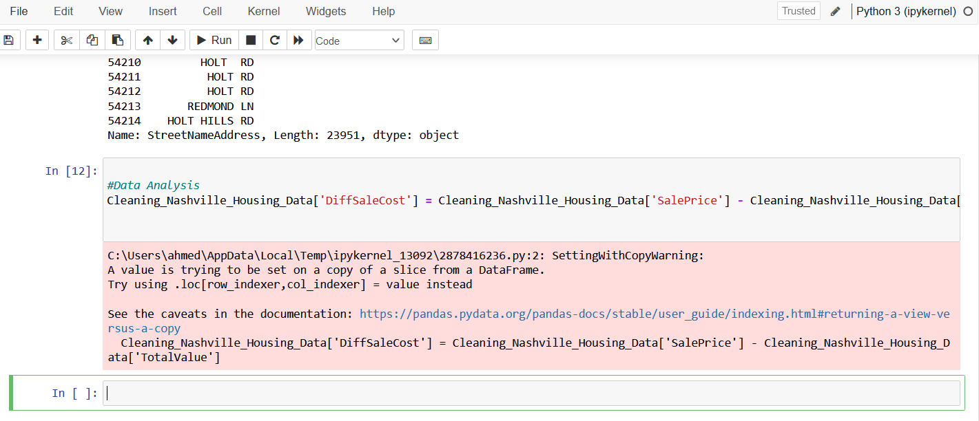
This code is formatting specific columns in the Cleaning_Nashville_Housing_Data DataFrame to have integer data types. By using the .astype(int) method, it converts the 'AgeAtSale', 'LandValue', 'BuildingValue', 'TotalValue', 'Bedrooms', 'FullBath', 'HalfBath', and 'YearBuilt' columns from their current data types to integers.
This kind of formatting is often done to ensure data consistency and to prepare for certain types of analysis that require numeric operations, as some operations can only be performed on numbers. The code does not display the DataFrame, but if you wanted to see the DataFrame after the formatting, you could print Cleaning_Nashville_Housing_Data or just write its name as the last line in a Jupyter notebook cell

Slide 28
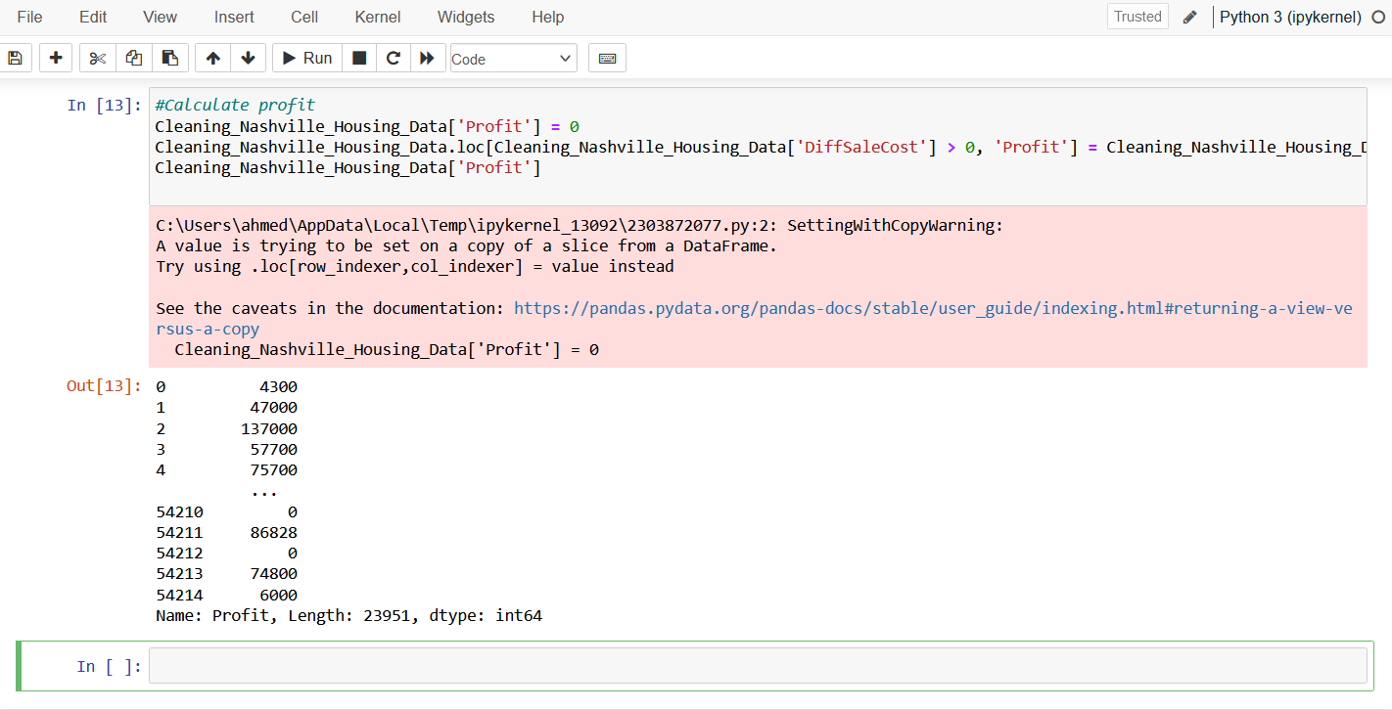
This code segments the 'PropertyAddress' in the Cleaning_Nashville_Housing_Data DataFrame into 'CityAddress', 'NumberStreetAddress', and 'StreetNameAddress' columns to detail city names, street numbers, and street names, respectively, enhancing data analysis by providing granular address information

Slide 29
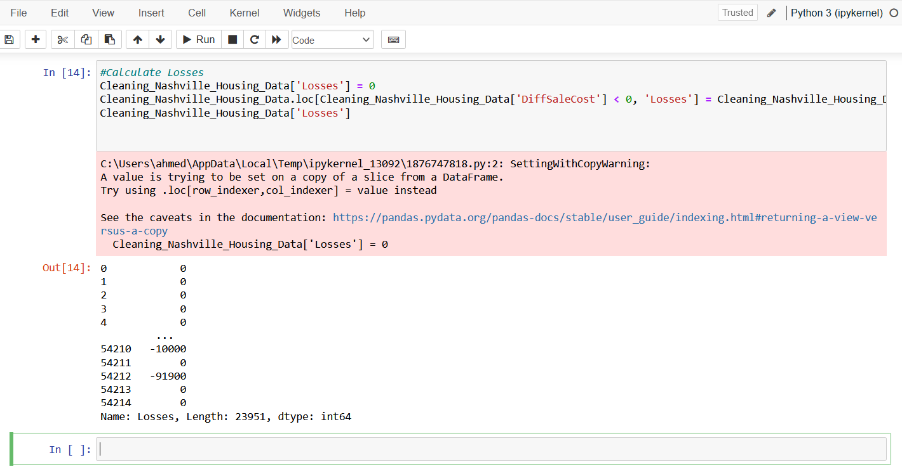
The code line you've shared adds a new column named 'DiffSaleCost' to the Cleaning_Nashville_Housing_Data DataFrame. This column represents the difference between the sale price of each property ('SalePrice') and its total assessed value ('TotalValue'). Essentially, this calculation shows whether the sale price was higher or lower than the assessed total value, providing insight into the real estate market conditions and valuation accuracy.
A positive value in 'DiffSaleCost' indicates that the property was sold for more than its assessed value, suggesting a seller's market or perhaps that the property has features valued by buyers that are not fully captured in the assessed value. Conversely, a negative value suggests the property sold for less than its assessed value, which might indicate a buyer's market, the property's overvaluation, or that the seller needed to sell quickly

Slide 30

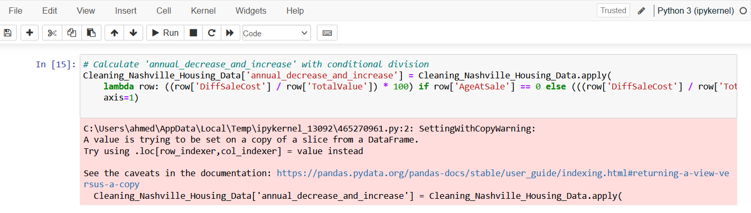
The provided code calculates and adds a new column named 'Profit' to the Cleaning_Nashville_Housing_Data DataFrame. Initially, all values in this 'Profit' column are set to 0. Then, for rows where 'DiffSaleCost' is greater than 0 (indicating that the sale price was higher than the total value, thus a profit was made on the sale), the 'Profit' column is updated with the value from 'DiffSaleCost'.
This approach effectively segments the data into profitable and non-profitable sales, with the 'Profit' column reflecting the profit amount where applicable and remaining at 0 for sales that did not result in a profit (where the sale price did not exceed the total value). This column can be used for further analysis to understand profitability patterns within the dataset

Slide 31

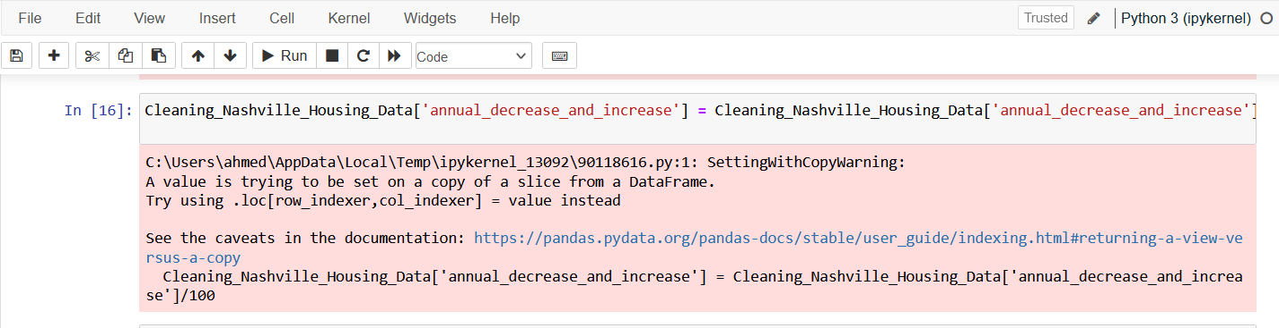
The code snippet provided adds a new column named 'Losses' to the Cleaning_Nashville_Housing_Data DataFrame and initializes all its values to 0. It then updates this 'Losses' column for rows where the 'DiffSaleCost' is less than 0, indicating that the sale price was lower than the total assessed value, and thus, a loss was incurred on the sale. For these cases, the 'Losses' column is set to the value of 'DiffSaleCost', representing the amount of loss.
This process mirrors the earlier calculation of profit, but focuses on identifying and quantifying losses from property sales. The 'Losses' column will show the loss amount where applicable, and remain at 0 for sales that did not result in a loss (where the sale price was equal to or exceeded the total value). This detailed segmentation between profits and losses allows for more nuanced financial analysis of the real estate project's outcomes

Slide 32
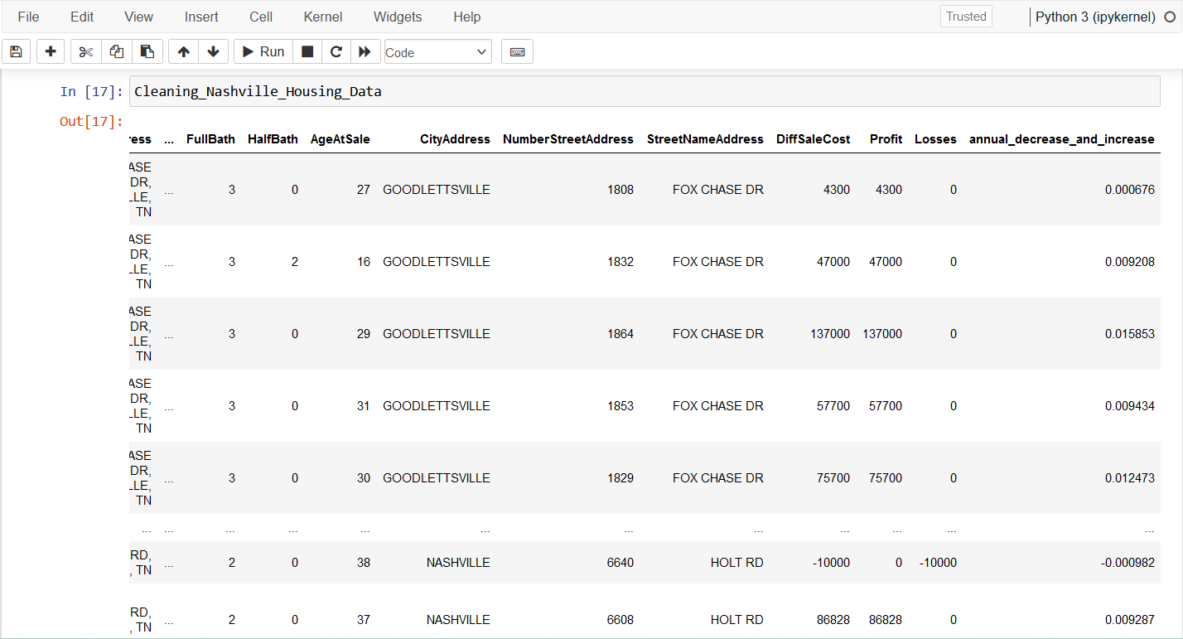
The code adds an 'annual_decrease_and_increase' column to track yearly value changes of properties in Cleaning_Nashville_Housing_Data, calculating immediate percentage change for properties sold within their build year, and annualized change for older properties. This reveals how property values fluctuate over time relative to their age and assessed value

Slide 33
This code adjusts the 'annual_decrease_and_increase' column in the Cleaning_Nashville_Housing_Data DataFrame by dividing each value by 100. This operation effectively converts the percentage values into a decimal format. For example, a value of 5%, which was previously represented as 5.0, will now be represented as 0.05. This conversion can make further calculations with these values more straightforward, especially if you're integrating them into formulas that expect ratios or fractions instead of percentages

Slide 34
This is final table after cleaning and adding new columns and after analysis

Slide 35

Conclusion
Through data cleaning and analysis, we've identified key trends and patterns in the Nashville real estate market. Properties show a range of profit and loss outcomes, with seasonal sales peaks and a general trend of increasing sales and profit over the years. The introduction of the 'annual_decrease_and_increase' metric allows for a nuanced understanding of property value changes over time. The analysis has underscored the importance of location, as seen in the disparities in land values across different cities, and highlighted the impact of property attributes on sale prices. Overall, the project reveals a complex but gradually appreciating real estate market in Nashville, offering valuable insights for stakeholders to make informed decisions

